Slide 1
Wind Downscaling:Progress and Challenges Michael (2018) & Irma (2017)
Anil Kumar
Zaizhong Ma, and Roshan Shrestha, Avichal Mehra, Andre Van der Westhuysen, Saeed Moghimi & EMC team
September 2021
COASTAL-ACT ANNUAL MEETING (14-SEPTEMBER, 2021)

Slide 2
OUTLINE
WRF/LES FLOWCHART
WORKFLOW
Two Hurricane cases: Irma 2017 and Michael (2018) with two Forcings
Evaluation variables: Surface wind speed, Surface wind direction, Surface Gust, Surface Pressure
Observations
Station data
Doppler Radar composite
Surface wind estimation from multi-satellite + aircraft measurement methods. Note - This particular observation is not 100% accurate and has many limitations and biases as well. Using this observation is to give some idea of wind speed distribution spatially.
VALIDATION SCRIPTING AND 90% ACCURACY
SUMMARY

Slide 3
COASTAL-Act Model experiment design
HWRF FORCINGS
(DA, ensemble )
LANDUSE (30-METER) 40 CATEGORIES NLCD(2011)
ELEVATION- USGS (2013) 1/3
arc-sec, 10-METER RES
WPS
SYSTEM
2D Surface winds, sfc pressure
From URMA/RTMA
Hourly
NUDGING
WATER INUNDATION
Max water surface elevation from ADCIRC model
(Time-Dependent)
Urban processes Module
(activated)
OUTPUTS (Surface) 15 mins average
Sfc Wind Speed Max (m/s), U10 & V10 Time of Max Sfc Wind speed, Mean wind speed 6. Standard Dev. Wind Speed, Mean SLP, 30-meter LANDUSE, 10-meter ELEVATION TERRAIN, Water Inundation mark
Fine simulation WRF-LES
(10-30 meter)
OUTPUTS (ATMOSPHERE) 15 mins average
1. Wind Speed Max (m/s) 2. Max Updraft Helicity 3. Updraft Helicity 4. Max Z-wind updraft 5. Max Z-wind downdraft 6. Mean Z-wind 7. Max col integrated Graupel

Slide 4
WRF-LES Workflow
📁 sorc/
📁 WPS
📁 WRF 📁 exec/
geogrid
ungrib
metgrid
real
wrf 📁 docs/
< Documentation >
📁 ecf/
wrfles_prep.ecf
wrfles_forecast.ecf
wrfles_post.ecf 📁 jobs/
wrf_prep
wrf_forecast
wrf_post
📁 scripts/
wps & wrf_prep.sh
wrf_forecast.sh
wrf_post.sh
📁 parm/
wrf_configure
wps_configure
📁 ush/
WRF domain Wizard tool
Adcric_WRF_Regridding
wrf-ttest
wrf_post
📁 fix/
geog data
(landuse & 3DEB Elev data )
Tables

Slide 5
HURRICANE IRMA (2017)
WRF-LES
VALIDATIONS
HWRF FORCING & HRRR FORCING
During landfall, Large biases in the wind speed estimations with HWRF forcings and we want to test HRRR forcing as second option.
Note: We don’t have HRRR forcings available over
OCONUS islands

Slide 6
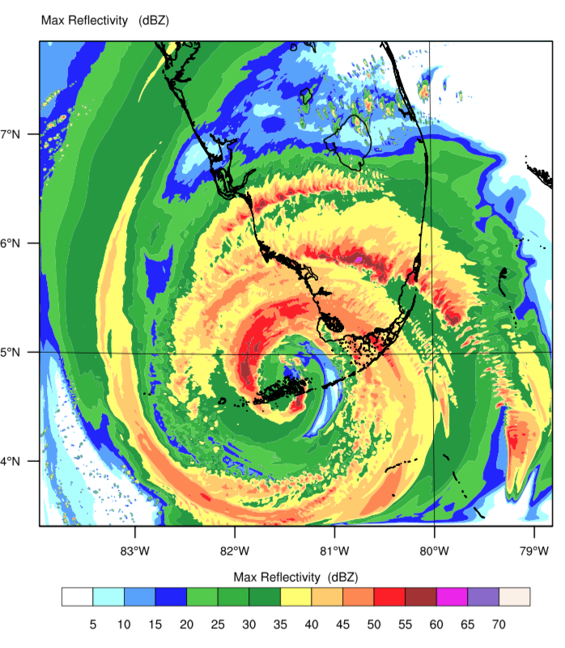
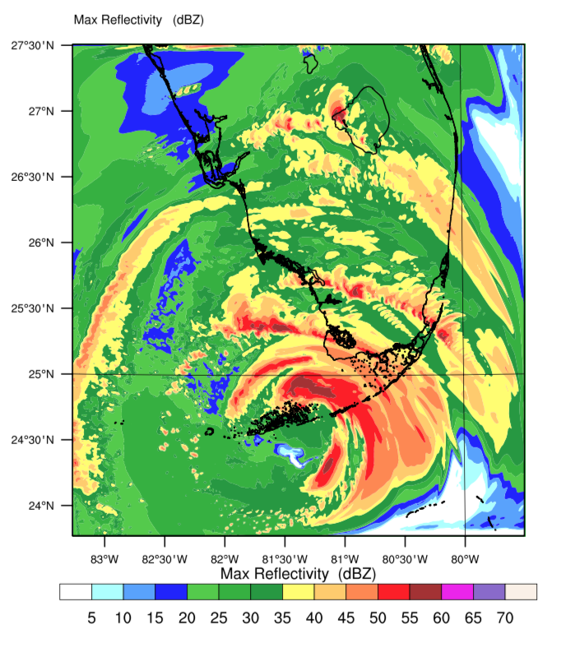
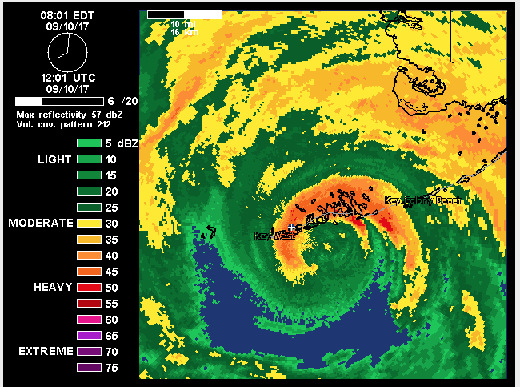
Reflectivity Composites
LES results using HWRF and HRRR forcing – from Domain-1 LES Output
12 UTC 10 SEPT 2017 (Landfall Time at Key West, FL)
Doppler Radar at 12 UTC
LES RESULTS USING HWRF
LES RESULTS USING HRRR
Eye location is better captured in LES result from HRRR forcing.
Very strong hurricane eye (overestimated) in HWRF based results.

Slide 7
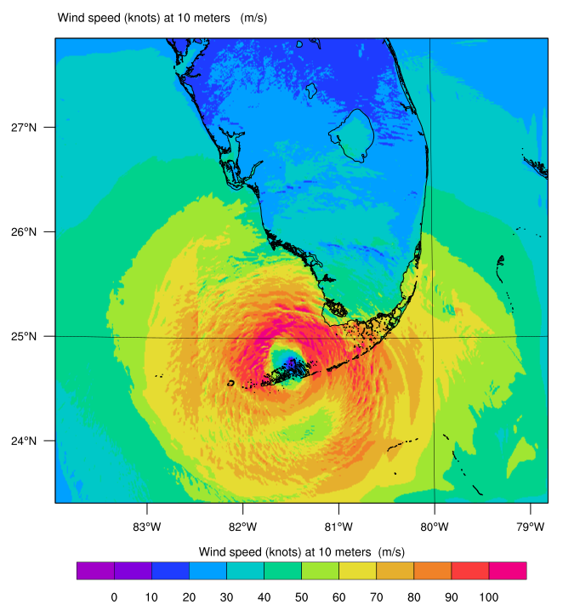
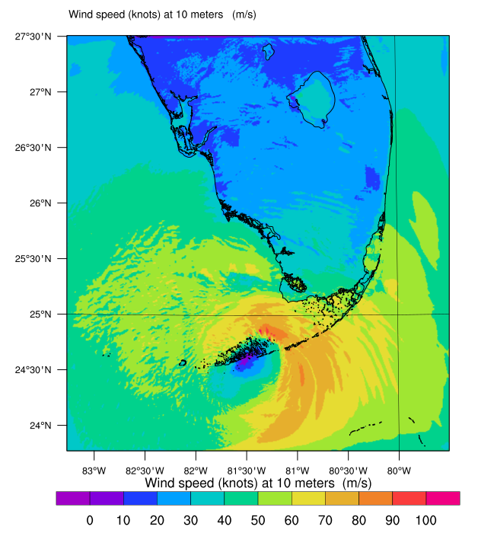
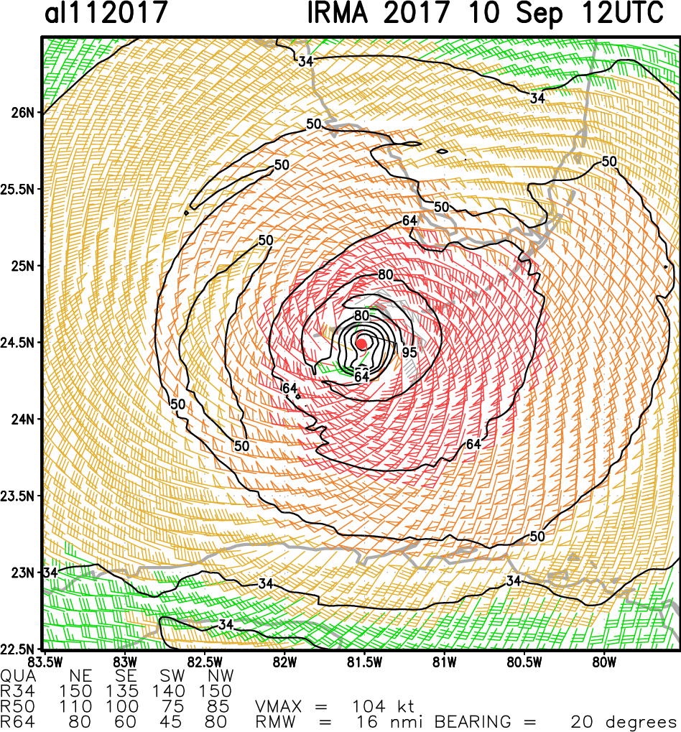
LES based Surface wind speed from HWRF and HRRR forcing – from Domain-1 LES Output
12 UTC 10 SEPT 2017 (Landfall Time at Key West, FL)
Satellite + Aircraft based Surface winds at 12 UTC
LES (HWRF) SFC Wind Speed
LES (HRRR) SFC Wind Speed
Surf wind speed is reasonable in the LES result from HRRR forcing.
Overestimated wind speed in HWRF based results >90 knots around the hurricane eye and much of the region.

Slide 8
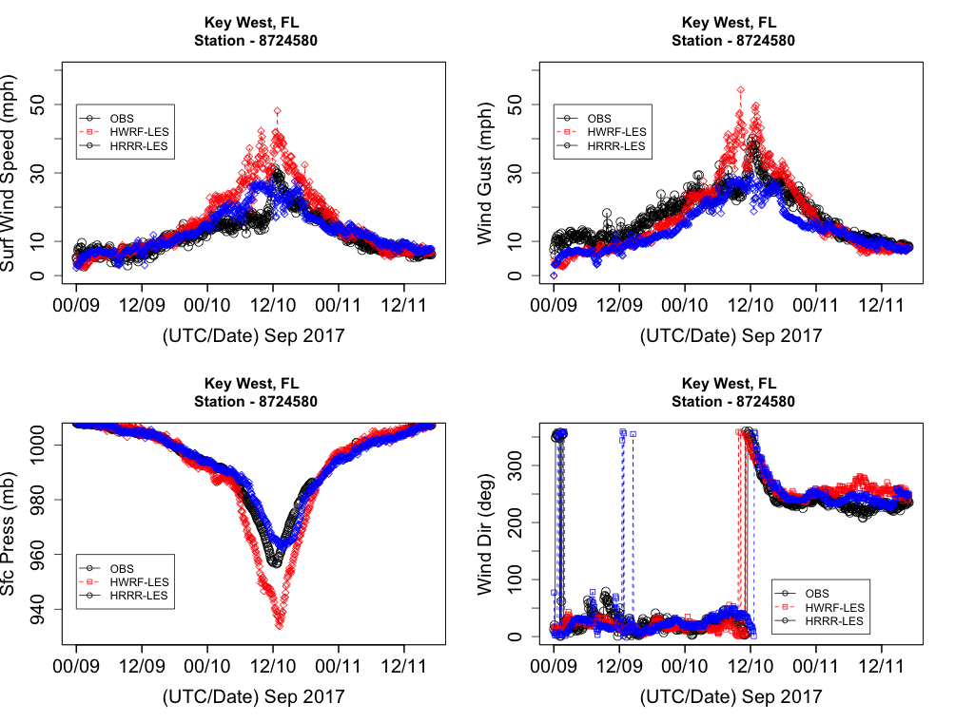
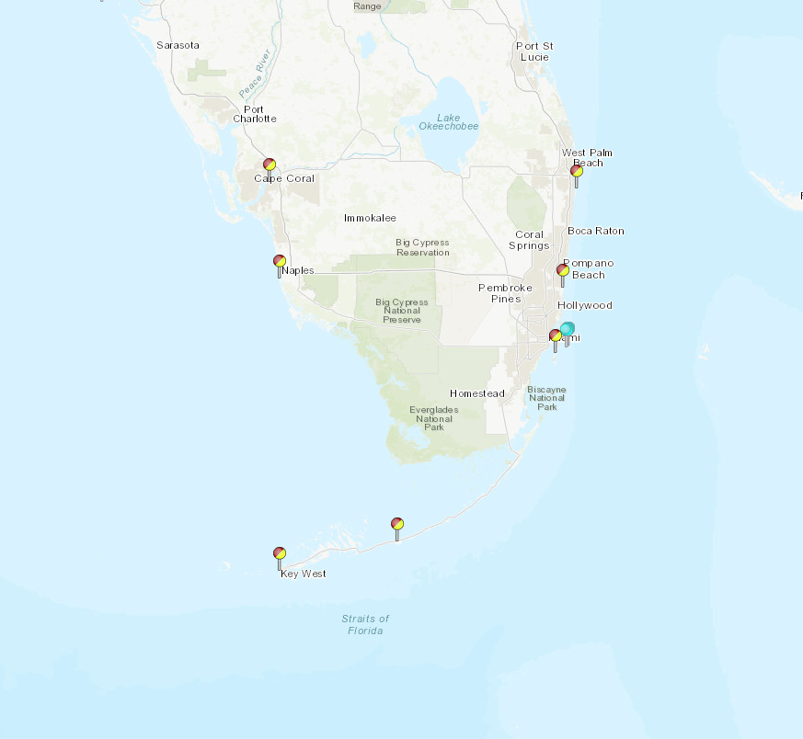
Key West, FL Station
LES results from HRRR forcing showed better results in surface wind speed, gust.
Surface pressure is accurately depicted in HRRR based results.
Wind direction are also much better from HRRR forcing based LES results.

Slide 9
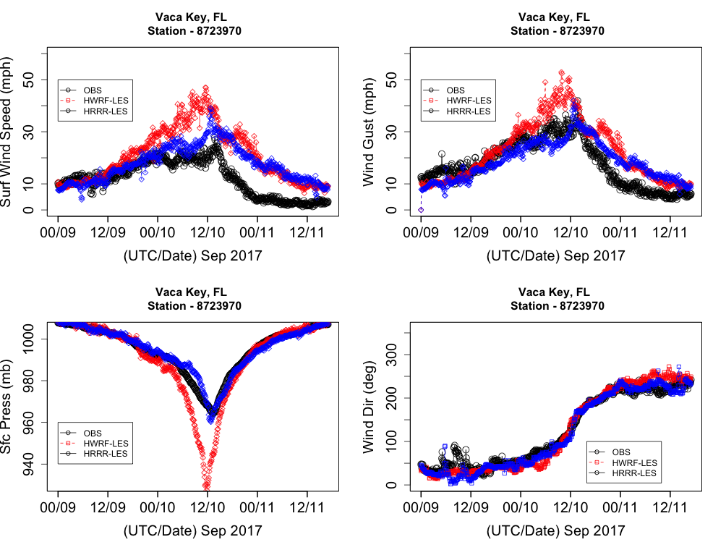
Vaca Key, FL Station
LES results from HRRR forcing showed better results in surface wind speed, gust. However large wind speed seen after landfall but better than HWRF based results.
Surface pressure is accurately depicted in HRRR based results.
Surface pressure from HWRF based results shows that strong eye and overestimation.
Wind direction are also much better from HRRR forcing based LES results.

Slide 10
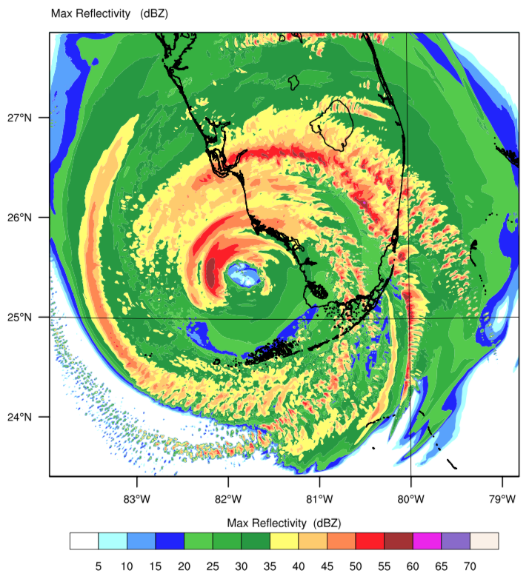
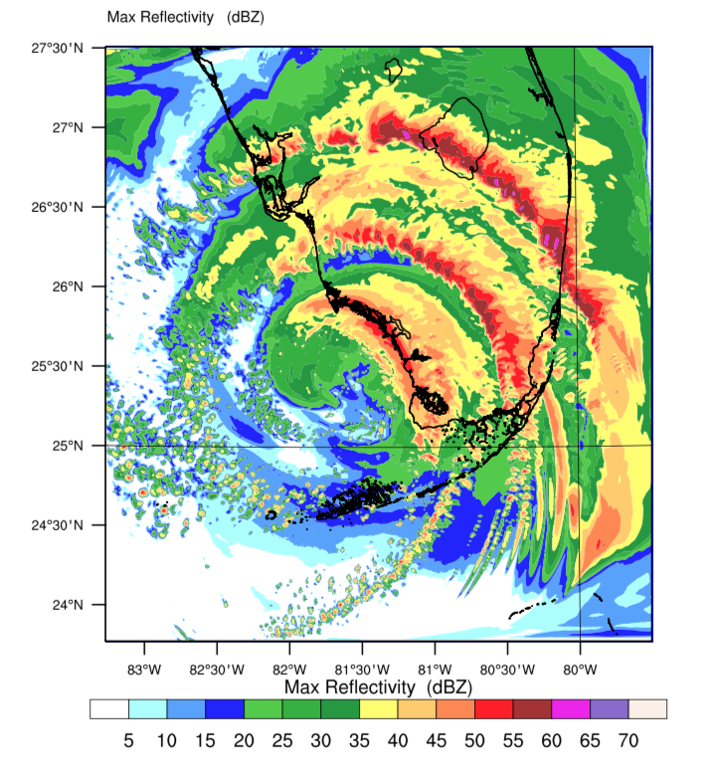
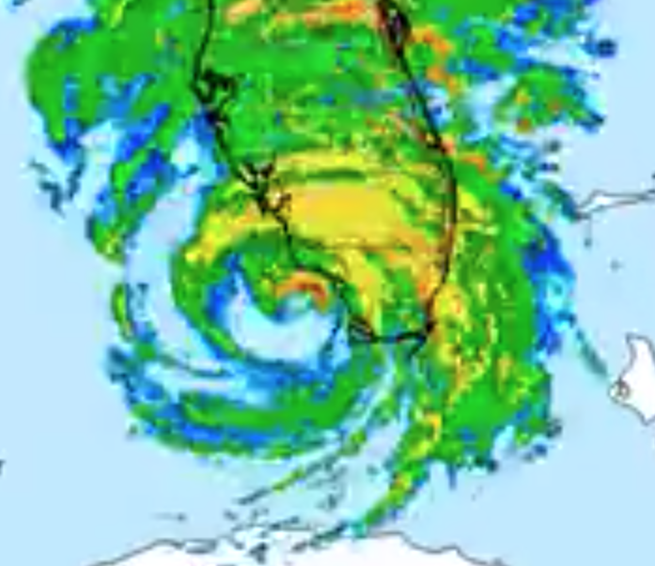
Reflectivity from LES using HWRF and HRRR forcing – from Domain-1 LES Output
18 UTC 10 SEPT 2017 (Landfall Time at Naples, FL)
Doppler Radar at 18 UTC
LES (HWRF) Max Reflectivity
LES (HRRR) Max Reflectivity
Eye location is better captured in LES result from HRRR forcing.
Very strong hurricane eye (overestimated) in HWRF based results. The strong bands are also not at right location as we see in observed radar.

Slide 11
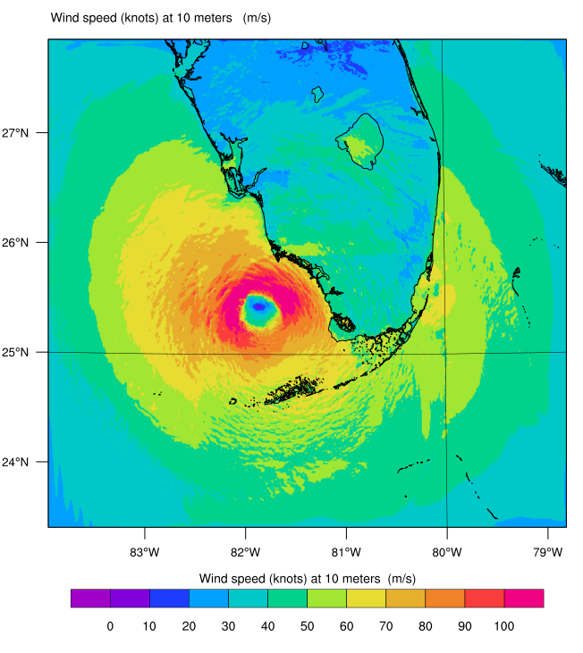
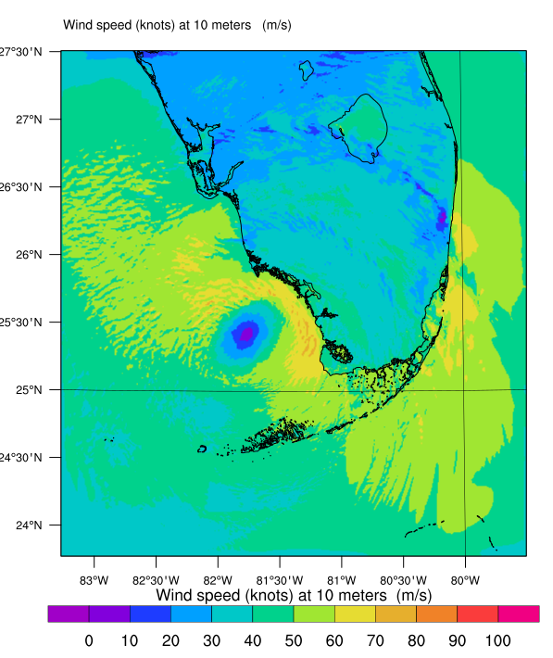
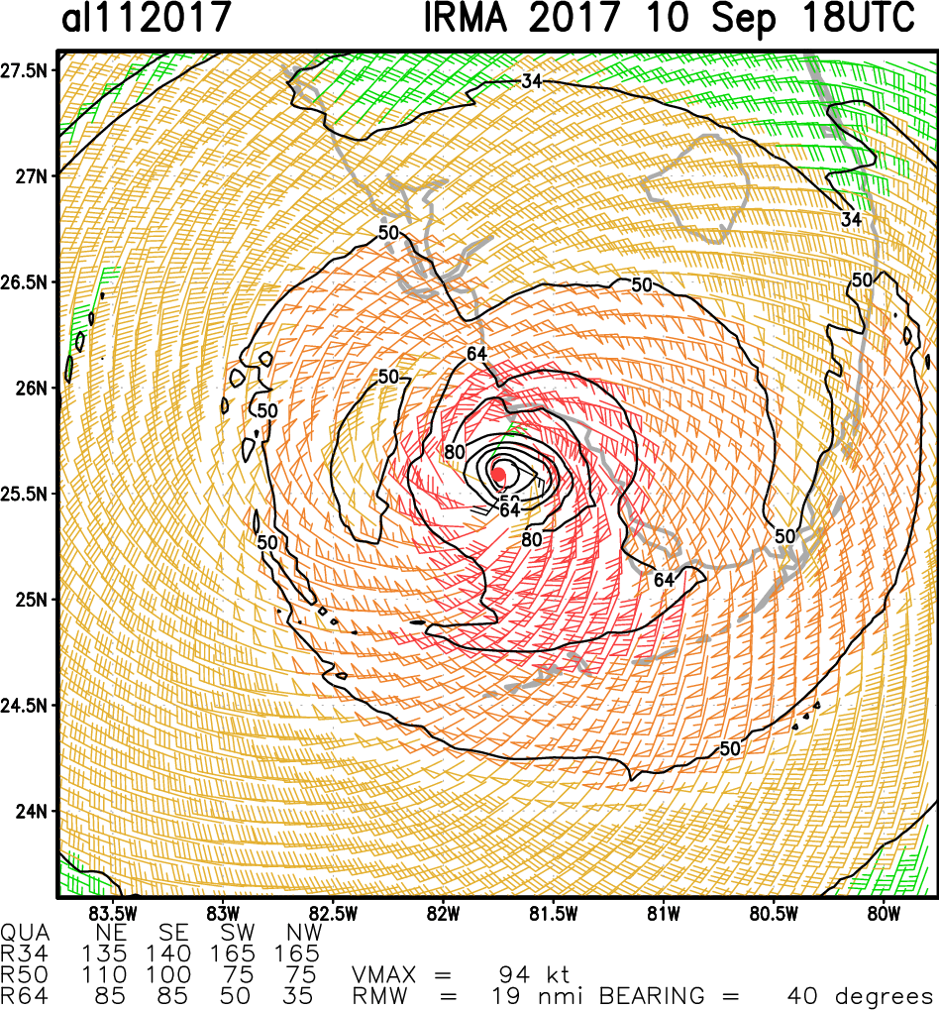
LES based Surface wind speed from HWRF and HRRR forcing – from Domain-1 LES Output
18 UTC 10 SEPT 2017 (Landfall Time at Key West, FL)
Satellite + Aircraft based Surface winds at 18 UTC
LES (HWRF) SFC Wind Speed
LES (HRRR) SFC Wind Speed
Surf wind speed is better captured in LES result from HRRR forcing (with some minor issues).
Overestimated wind speed in HWRF based results >90 knots around the hurricane eye and much of the region.

Slide 12
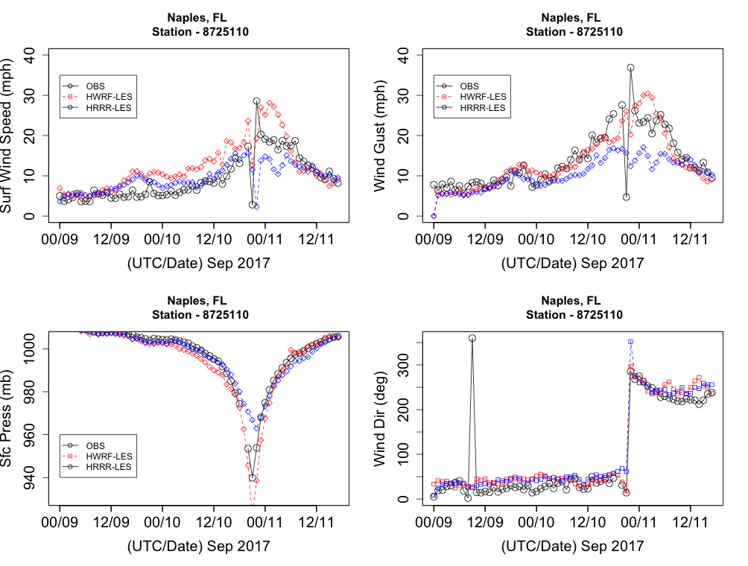
Naples, FL Station
Surface wind speed and Gust is a mix responses from both forcings.
Surface pressure is better in HWRF based results.
Wind direction are also mix response.

Slide 13
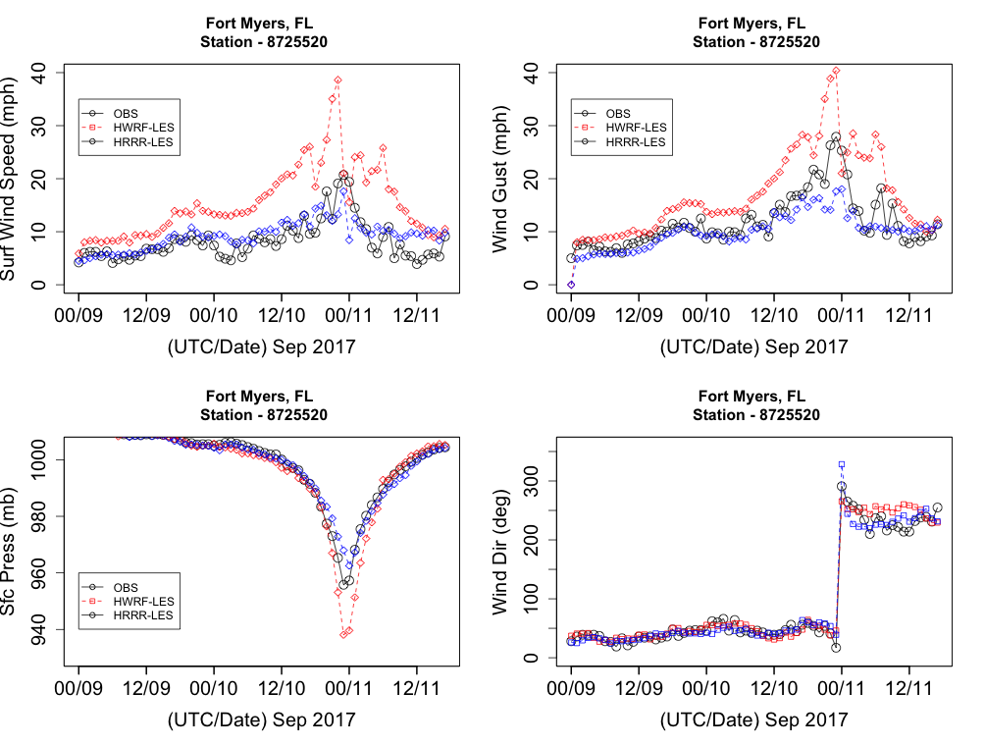
Fort Myers, FL Station
LES results from HRRR forcing showed better results in surface wind speed, gust.
HWRF forcing LES shows very high wind speed and gust biases.
Surface pressure is accurately depicted in HRRR based results.
Surface pressure from HWRF based results shows that strong eye and overestimation.
Wind direction are also much better from HRRR forcing based LES results.

Slide 14
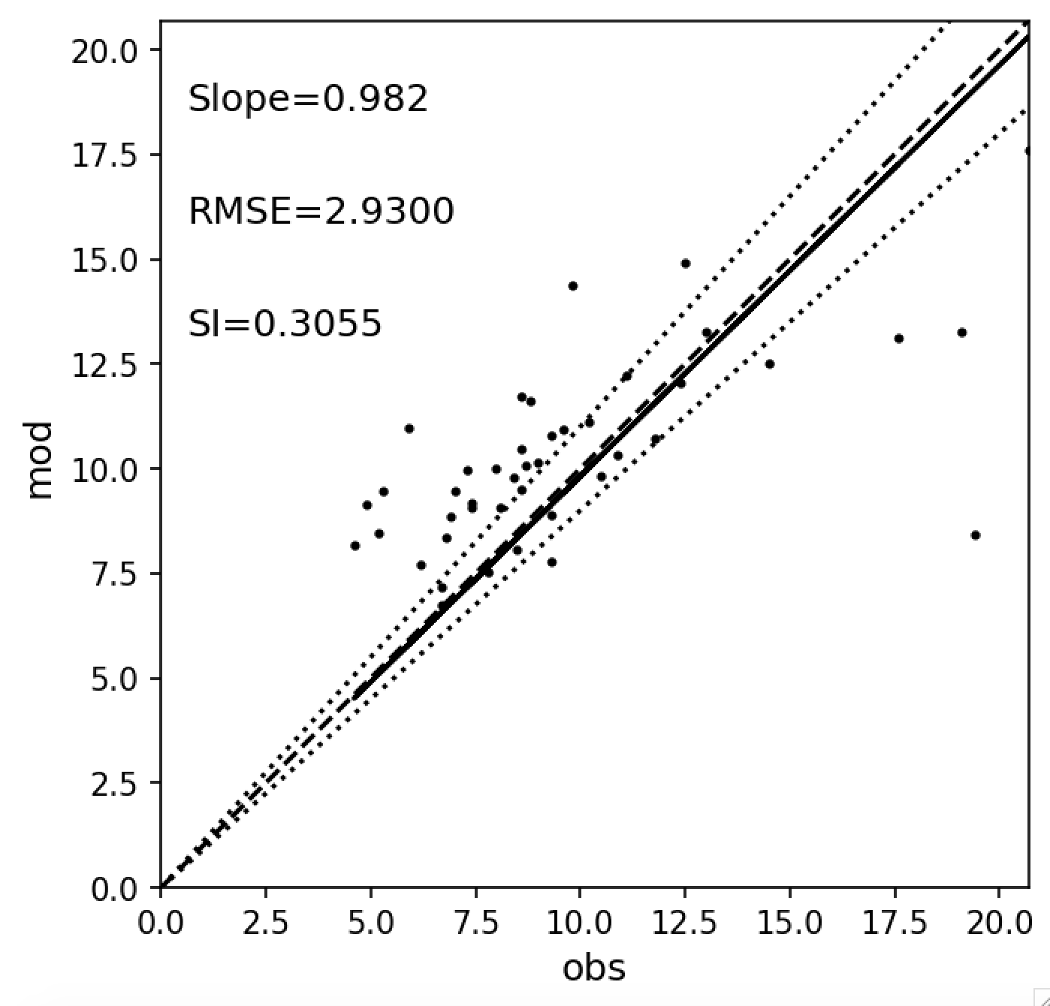
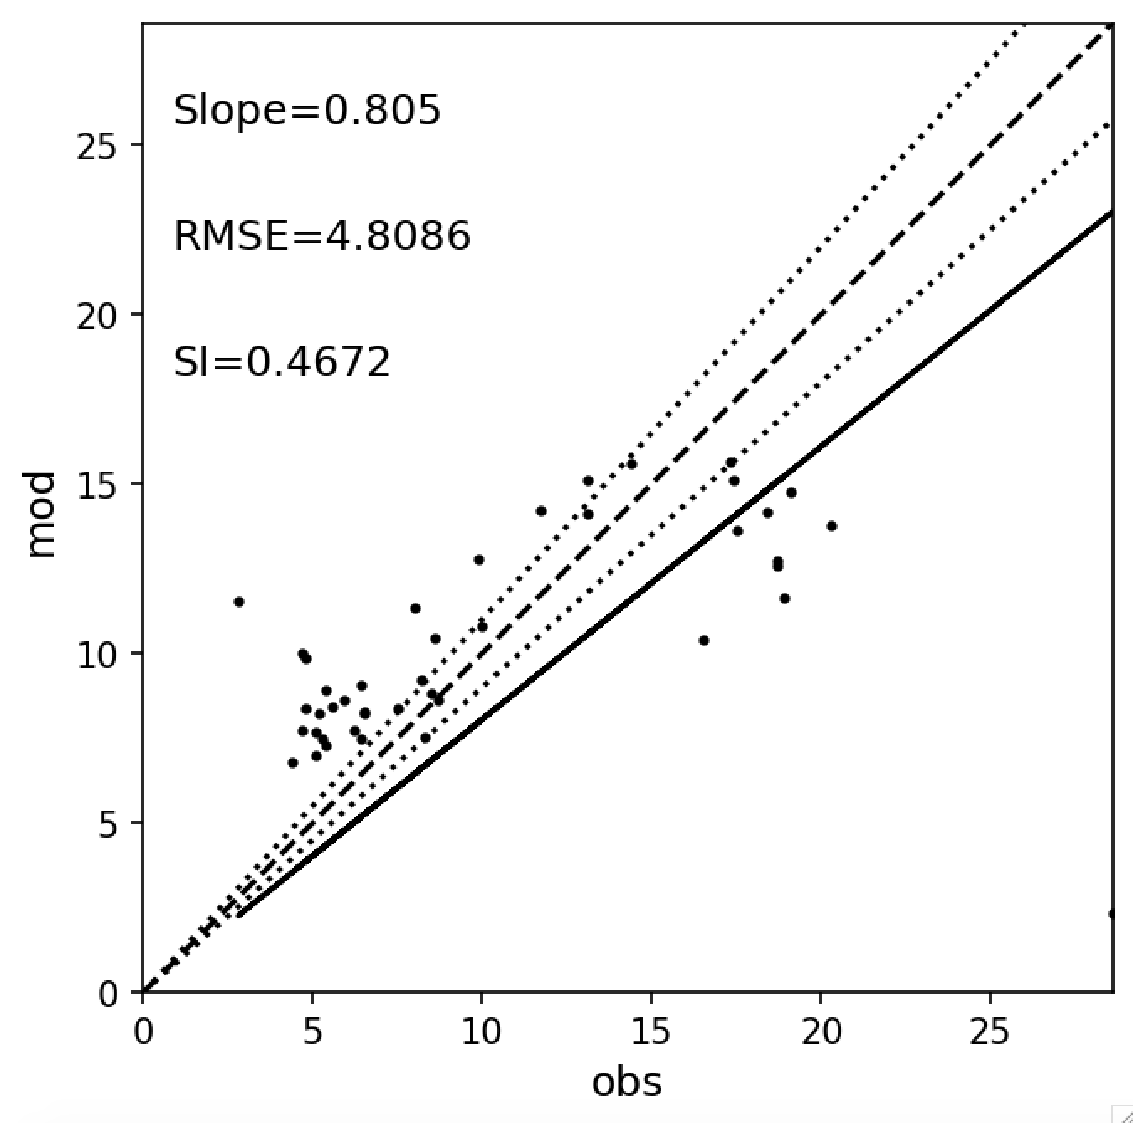
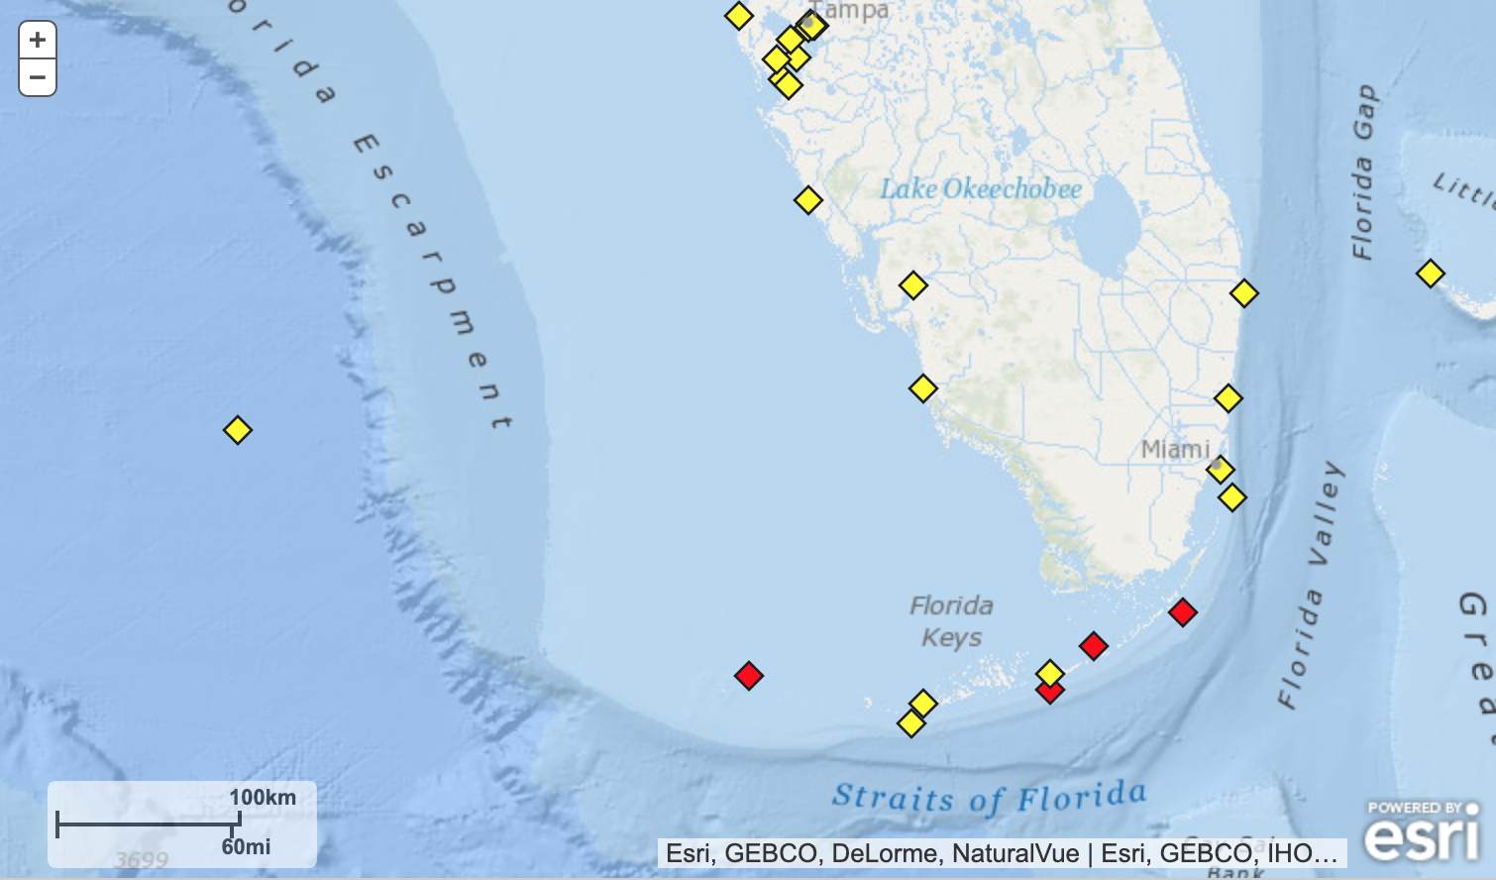
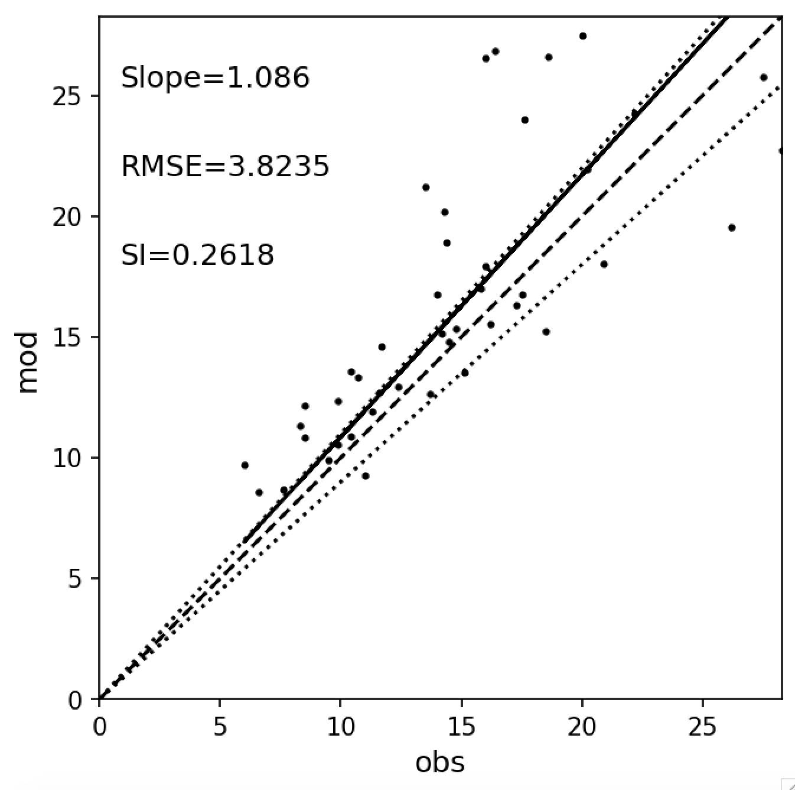
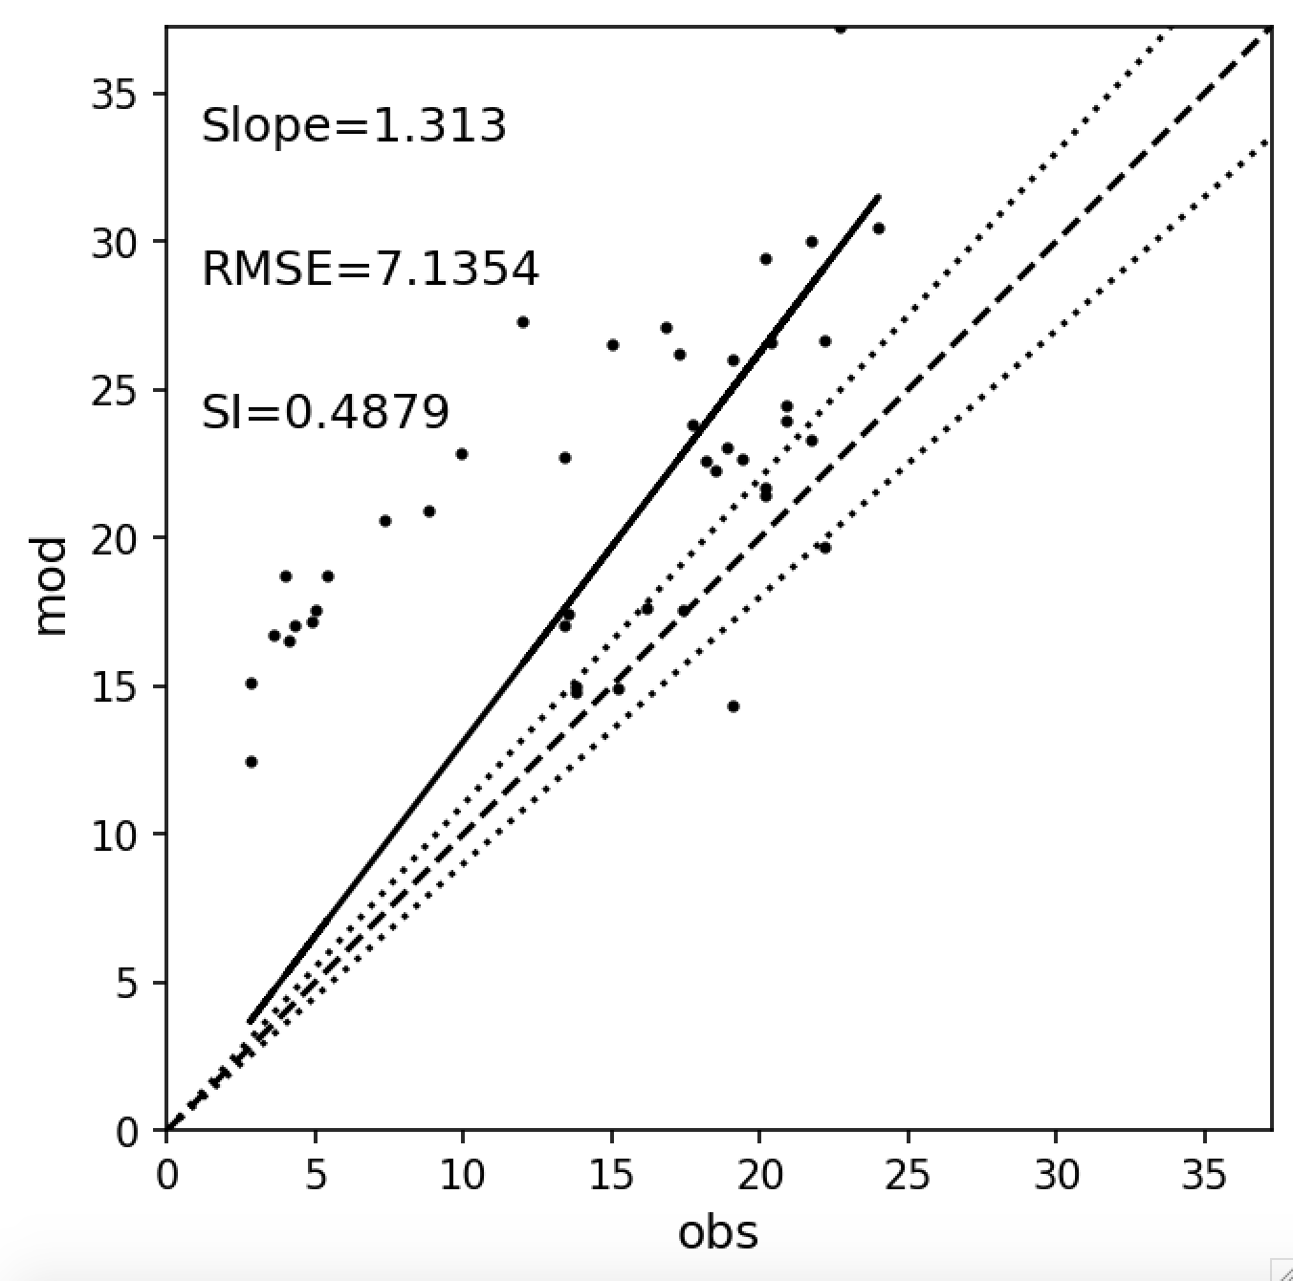
Tier 1: General error statistics (U10)
Fort Meyers
Naples
Fort Meyers
Naples
Vaca Key
Key West
Key West
Vaca Key

Slide 15
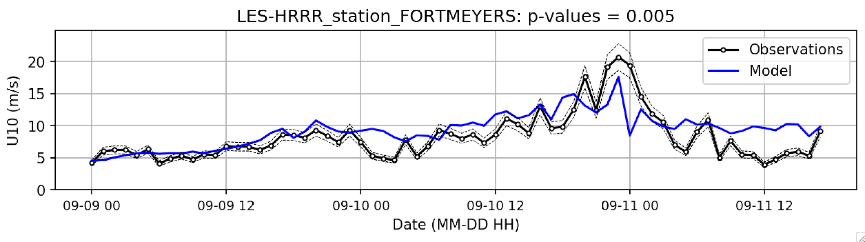
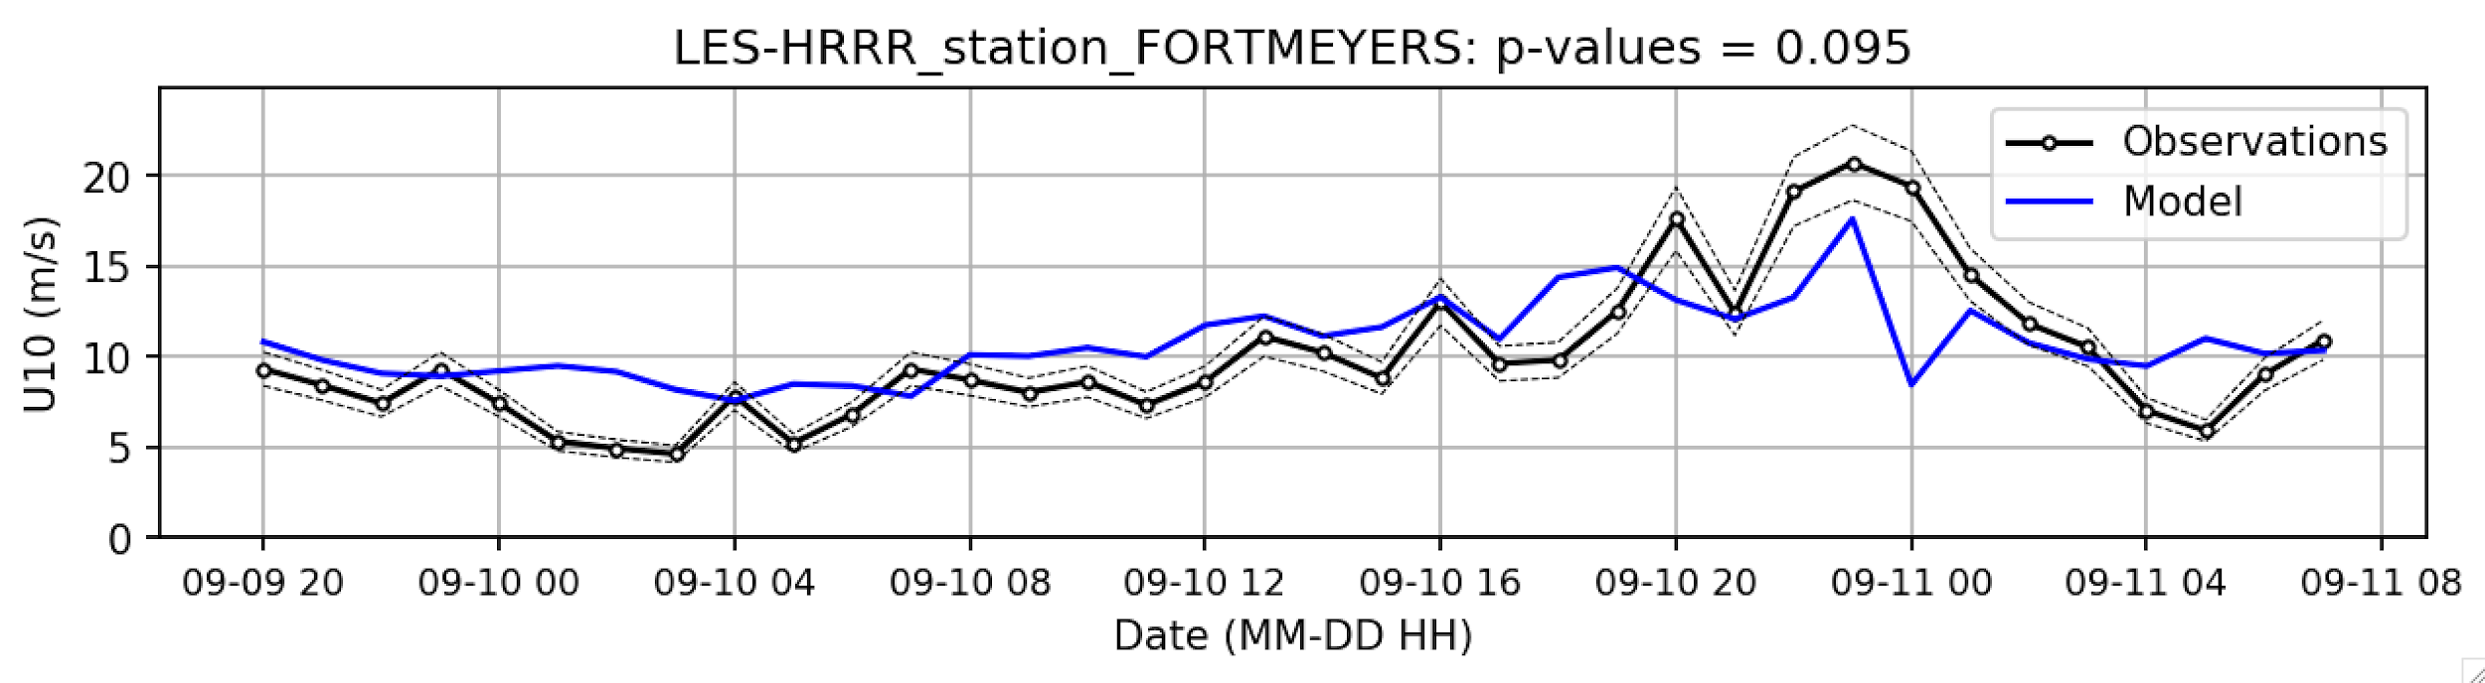
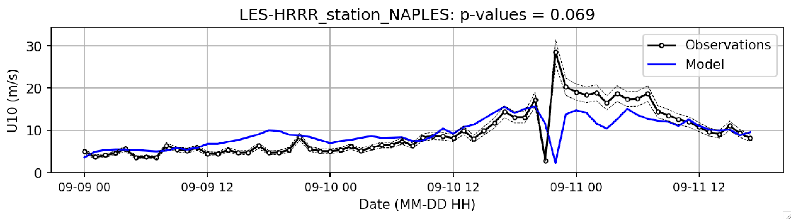
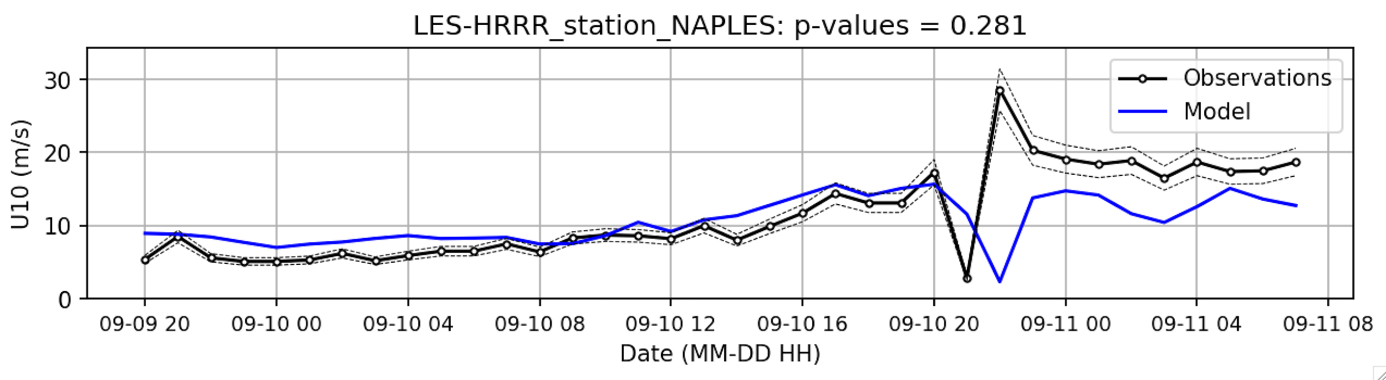
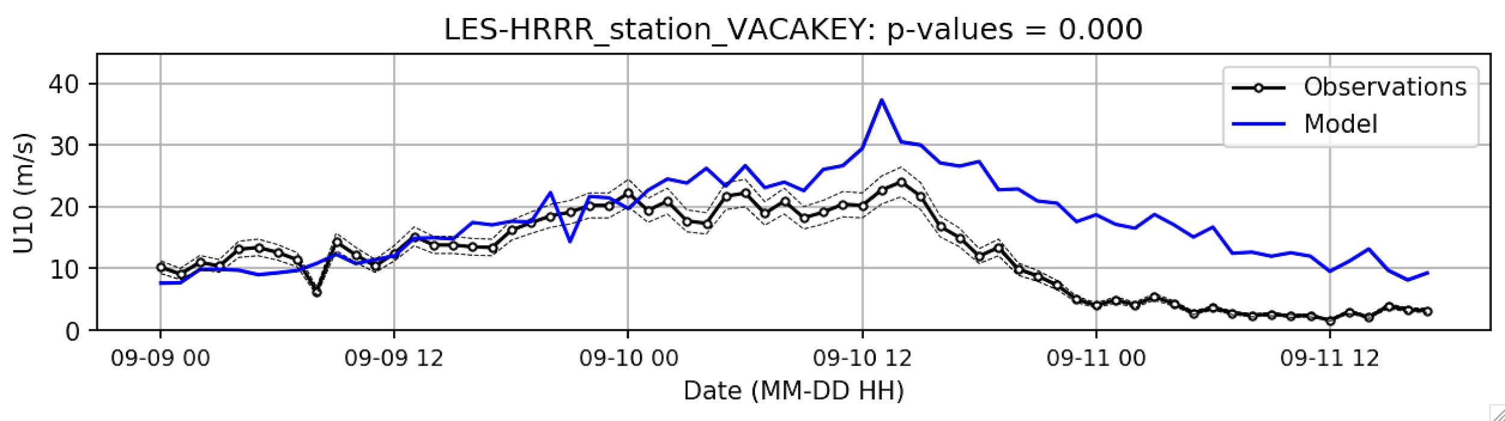
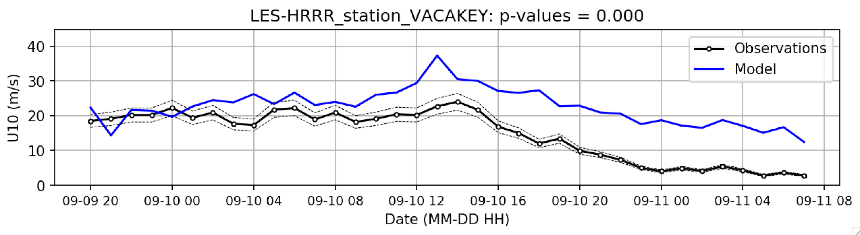
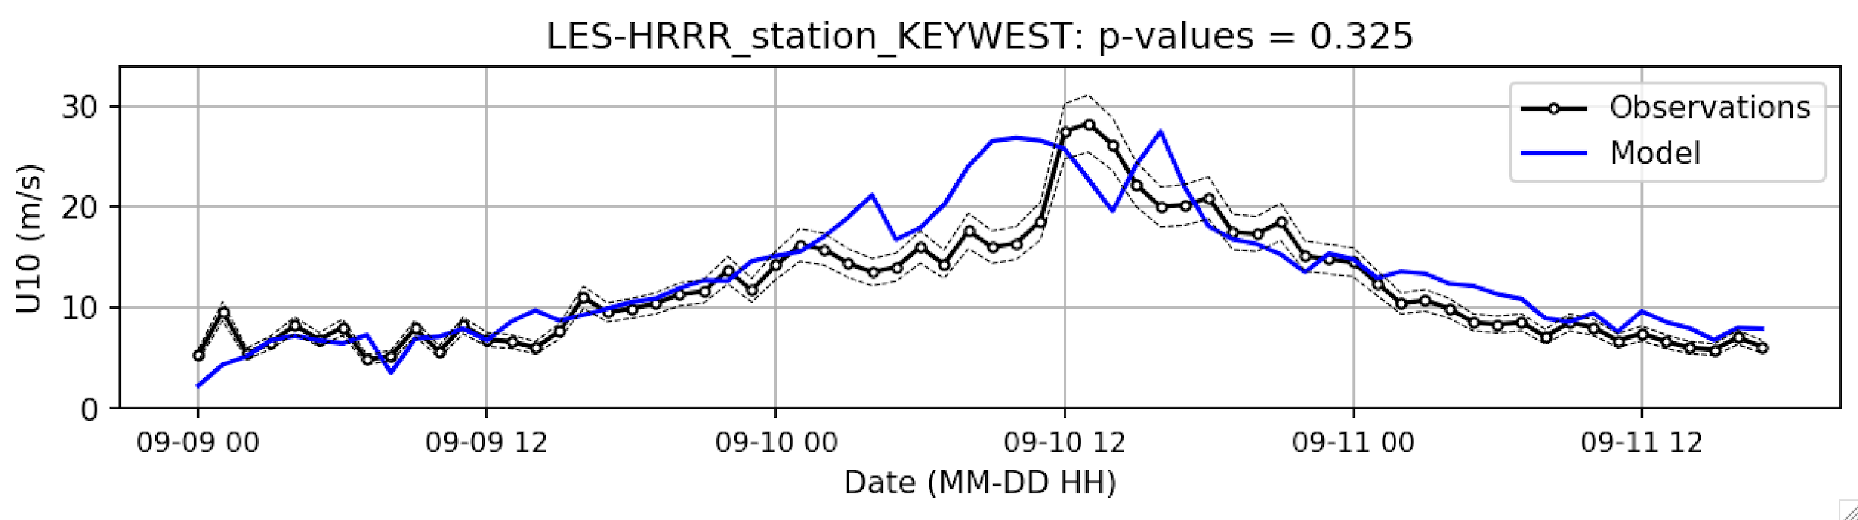
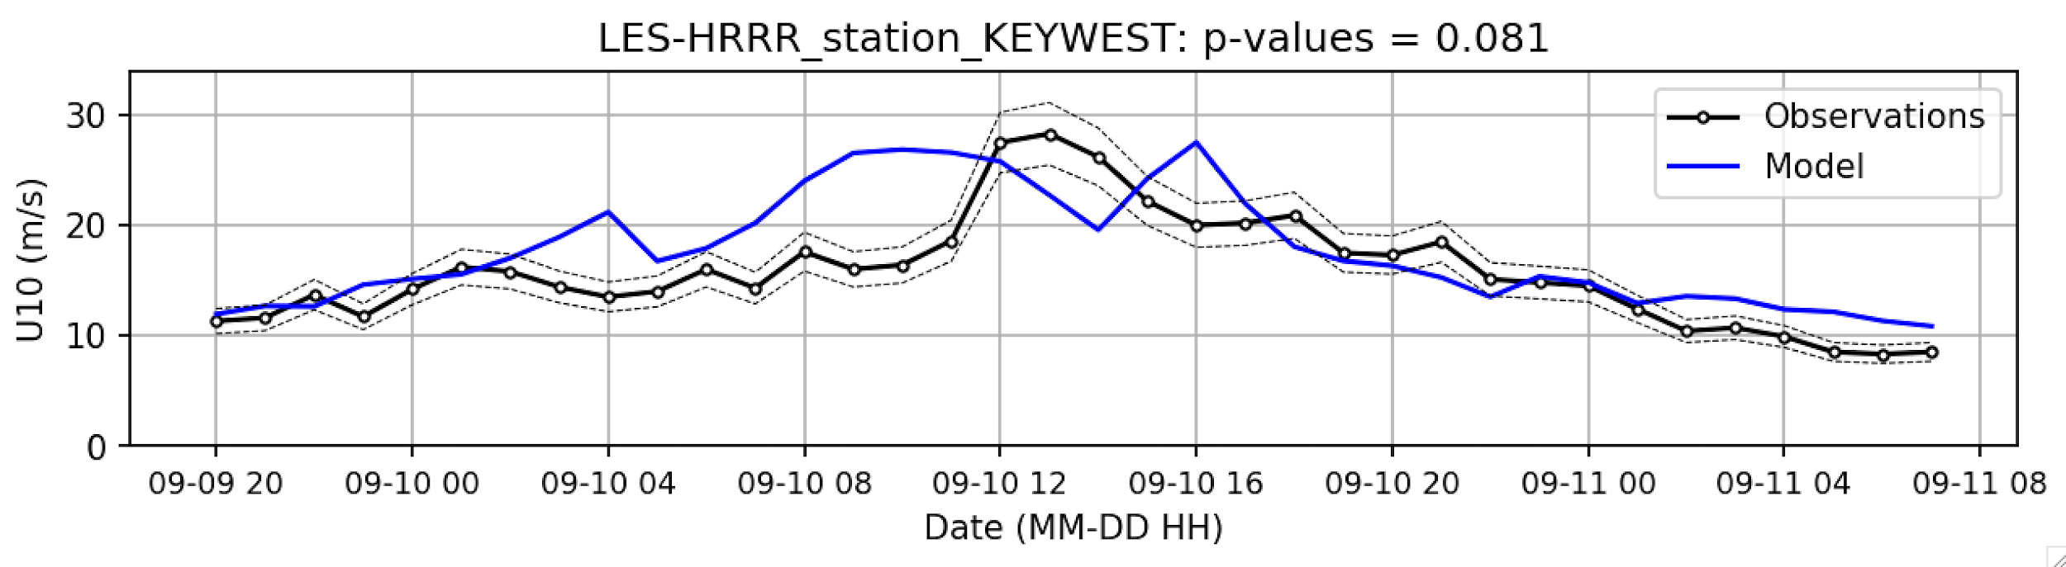
Tier 2: 90% accuracy with time window (U10)
FAIL
SUCCEED
SUCCEED
SUCCEED
FAIL
FAIL
FAIL
SUCCEED
SUCCEED

Slide 16
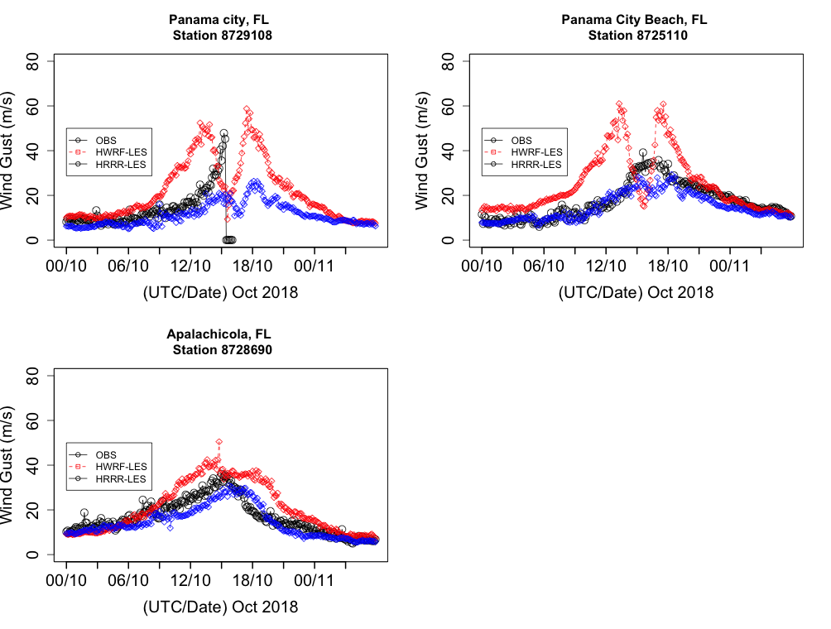
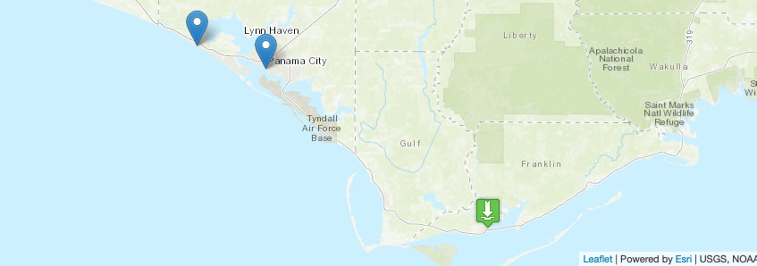
RECAP FROM HURRICANE MICHAEL 2018
RED – LES USING HWRF FORCING
BLUE – LES USING HRRR FORCING
BLACK – OBSERVATIONS
6-MINS INTERVAL DATA & MODEL VALIDATIONS
WIND GUST 6-MINS INTERVAL OBS DATA & MODEL

Slide 17
SUMMARY
Two forcing options available- HWRF and HRRR: If HWRF forcing fails to get reasonable surface wind speed and gust along with surface pressure then we will use HRRR in that case.
Two cases analyzed : HURRICANE IRMA(2017) and HURRICANE MICHAEL(2018) cases using both HWRF and HRRR forcing conducted
Finding suggest that in both hurricane cases LES results with HRRR forcing is better option to choose in resolving spatial wind speed distribution and time series analysis.
Overall, out of four stations located near the hurricane eye, three stations showed reasonable results from HRRR in both hurricane cases.
It is proposed to conduct LES runs with both HWRF and HRRR forcing in parallel to save time. This would require a doubling of the core requirement to 2x 3000 cores.
Completed cases: Ike(2008), Sandy(2012), Florence(2018), Irma(2017), Michael (2018).
In-Progress: Hawaii case Issell (2014).

Slide 18
